Slide 1


Python Project
Recipes

Slide 2
Project Brief
Project Brief: Search
In this project you'll create a program to search for recipes based on an ingredient. The standard project uses the Edamam Recipe API, but can be changed to use a different API after completing the required tasks
Required Tasks
These are the required tasks for this project. Read the Edamam API documentation ★
https://developer.edamam.com/edamam-docs-recipe-api
2. Ask the user to enter an ingredient that they want to search for
3. Create a function that makes a request to the Edamam API with the required ingredient as part of the search query (also included your Application ID and Application Key 4. Get the returned recipes from the API response
5. Display the recipes for each search result

Slide 3
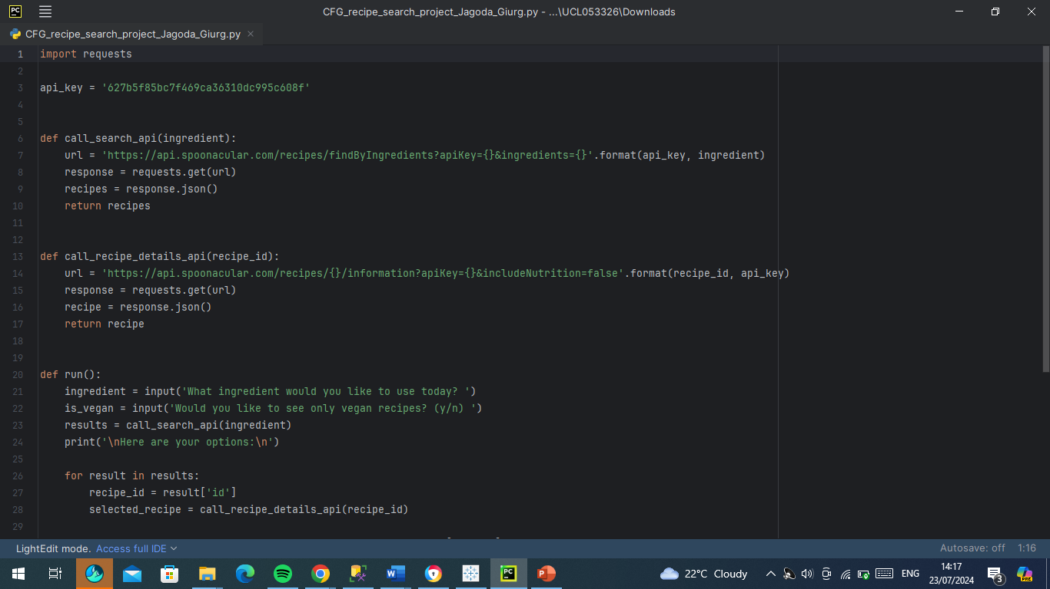
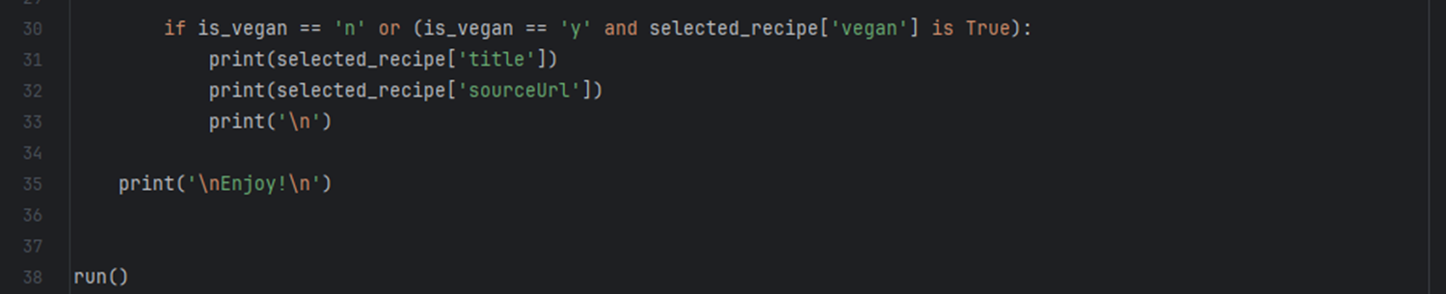
Code

